Slide 1

Database Keys
David Lyu
Cameron Meziere
Kaihang Zhao
Notes:
Cameron

Slide 2
Objectives
Learn about Three Types of Database Keys
Learn How To Initialize Database Keys
Explore Uses of Keys
Drop Database Keys If Necessary
Notes:
Cameron

Slide 3
What are Database Keys?
Three Types: Primary, Unique, and Foreign
Constraints on Tables
Keys can be used to ensure data integrity
Keys are used to efficiently search databases or establish relationships between databases

Slide 4
Primary and Unique Keys
Minimal subset of columns that uniquely identify a row in a database
ssn | first_name | last_name
152711856 | Cameron | Meziere
548801478 | Jessica | Kearns
108157078 | Jessica
446381146 | Tomas | Stanton
Unique Key
Primary Key
Notes:
Cameron

Slide 5
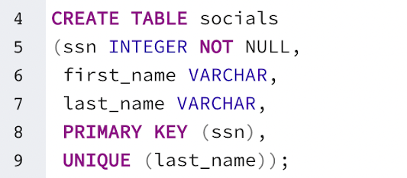
Initializing Primary and Unique Keys
ssn | first_name | last_name
152711856 | Cameron | Meziere
548801478 | Jessica | Kearns
108157078 | Jessica
446381146 | Tomas | Stanton
Unique Key
Primary Key
Notes:
Cameron

Slide 6
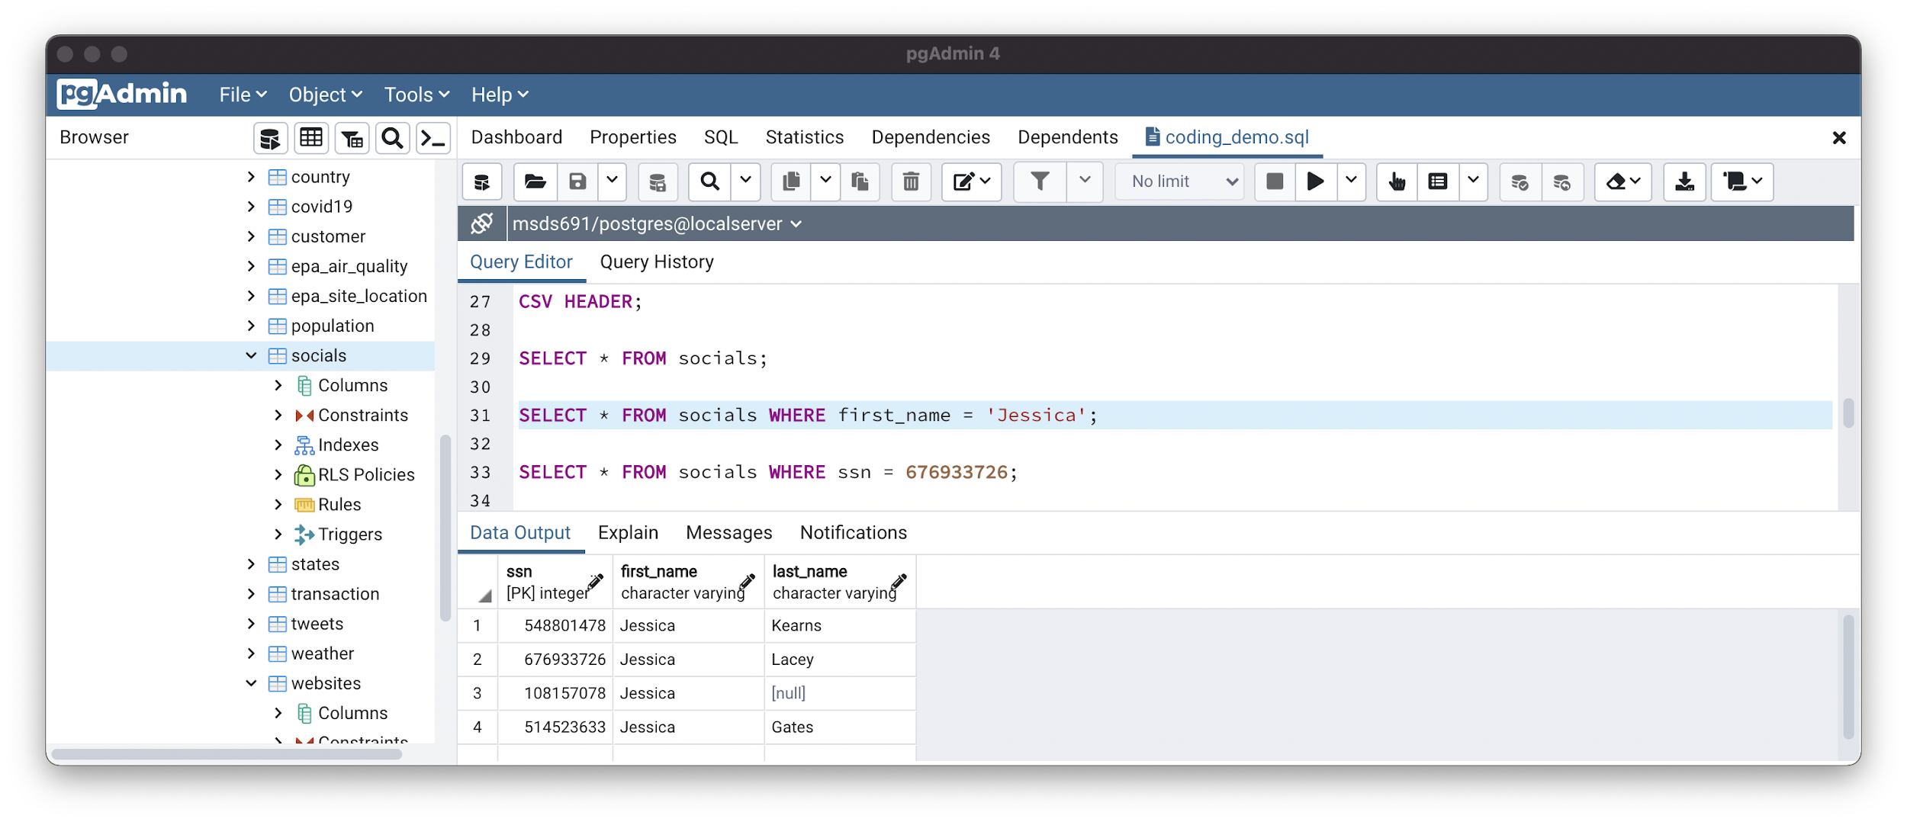
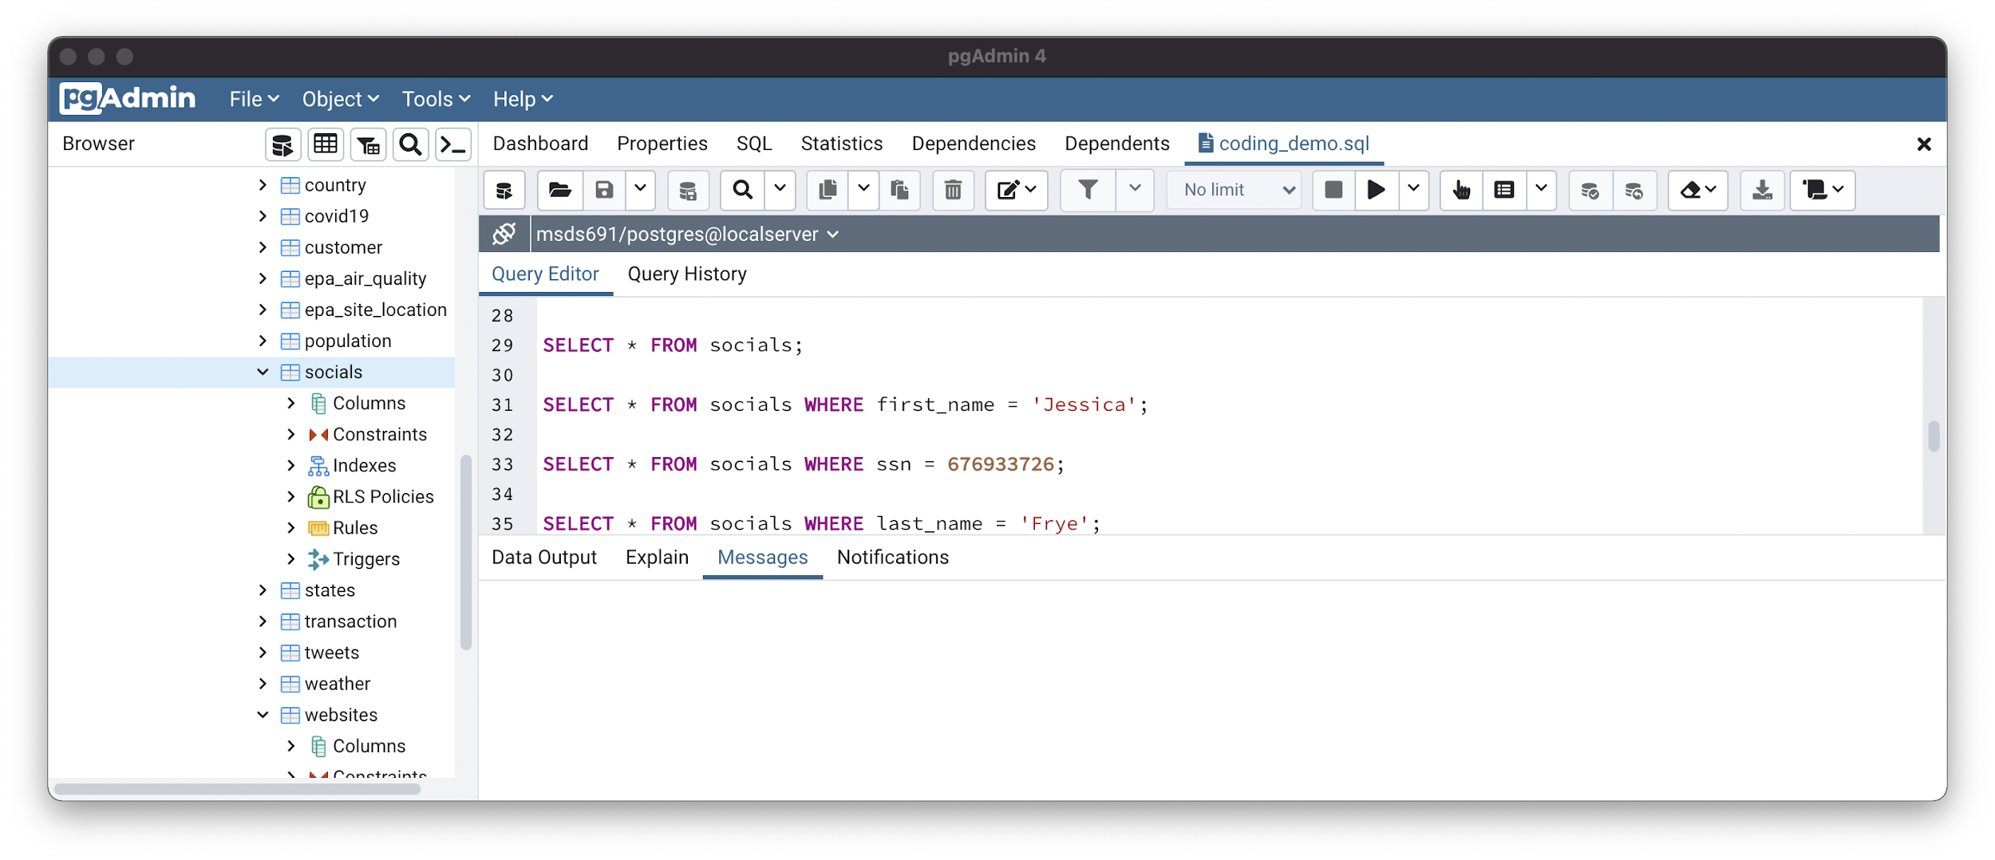
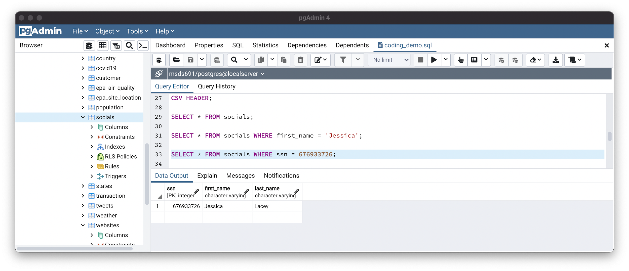
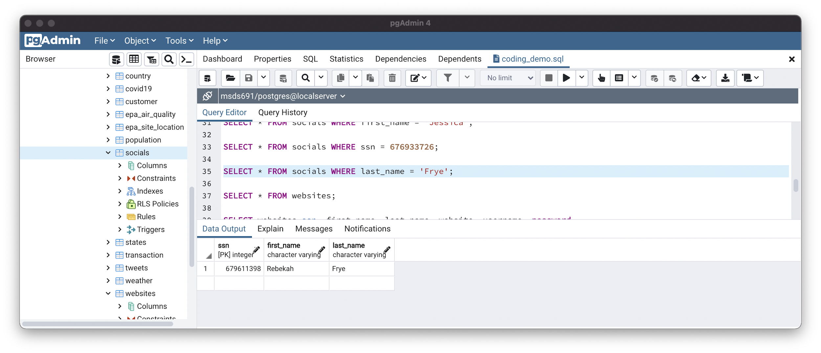
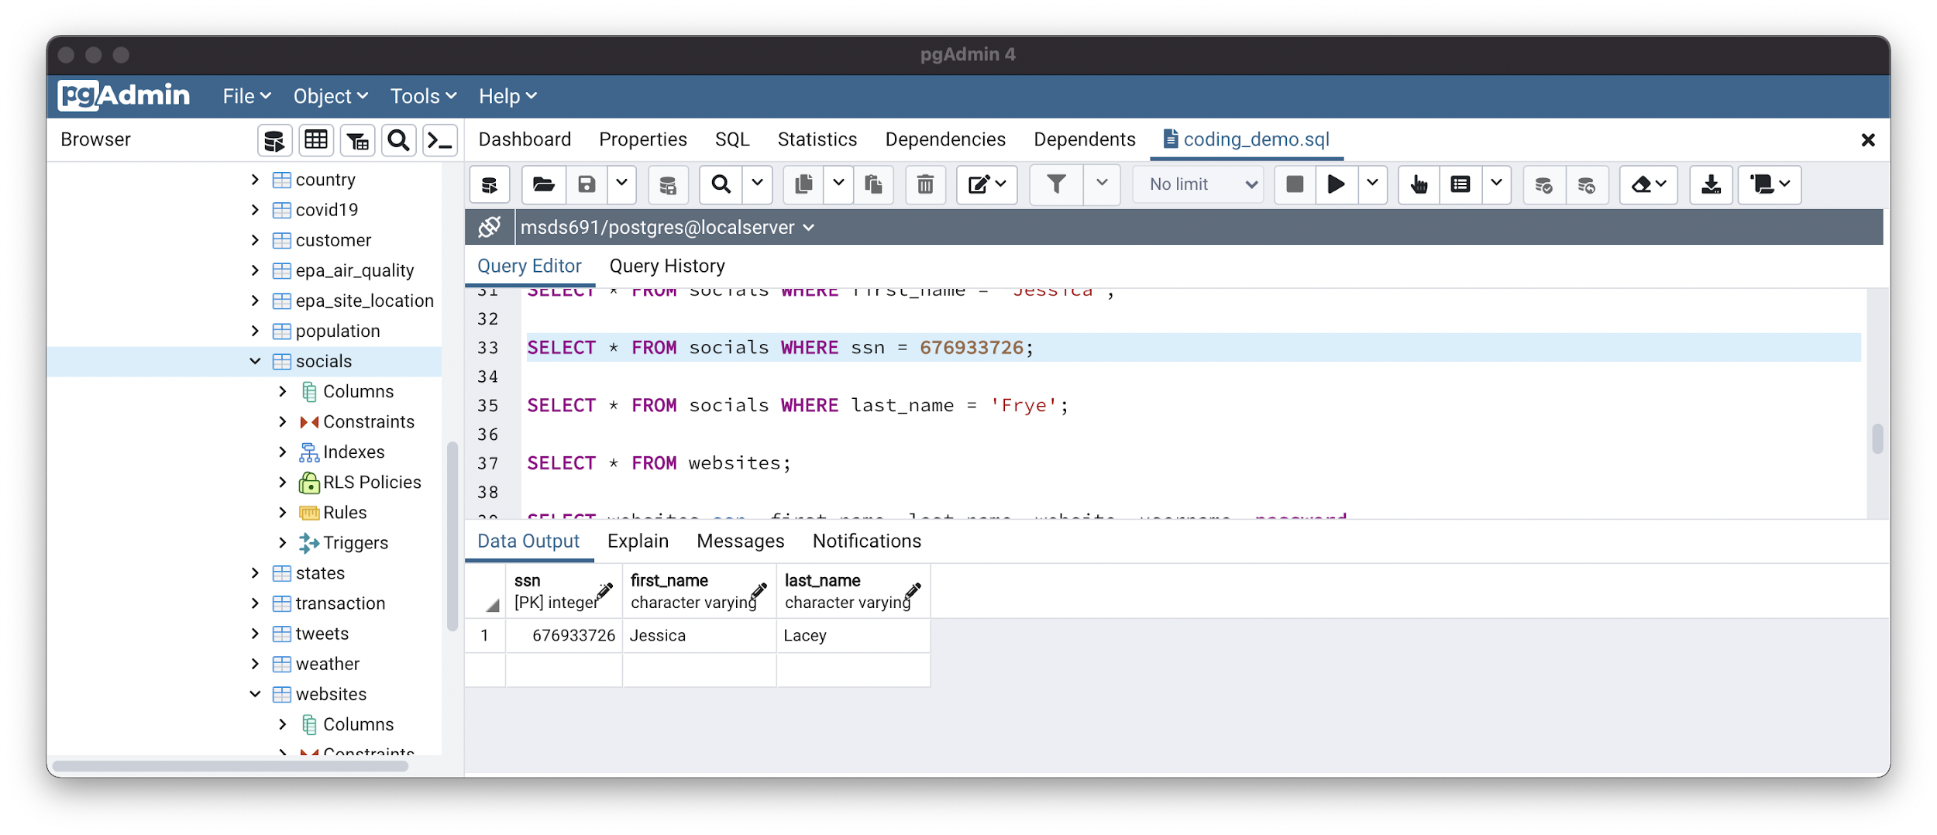
Use for Primary and Unique Keys
Not a Primary or Unique Key
Primary Key
Unique Key
Notes:
David

Slide 7
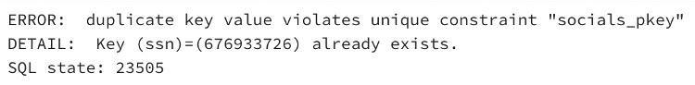
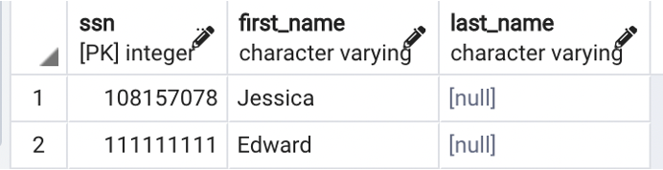
Primary and Unique Key Error
Violating Primary Key
Unique Key
Notes:
David

Slide 8
Foreign Keys
Links or relates the information in one table to information in another table
ssn | first_name | last_name
152711856 | Cameron | Meziere
548801478 | Jessica | Kearns
108157078 | Jessica
446381146 | Tomas | Stanton
Foreign Key
ssn | website | username | password
548801478 | irs.gov | jessicak | psswrd10
548801478 | state.gov | jessicak | psswrd10
108157078 | benefits.gov | jess108 | password1
446381146 | state.gov | tomass | godons18
Notes:
Kaihang

Slide 9
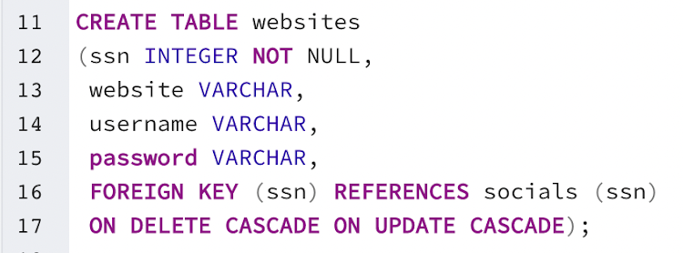
Initializing Foreign Key
ssn | website | username | password
548801478 | irs.gov | jessicak | psswrd10
548801478 | state.gov | jessicak | psswrd10
108157078 | benefits.gov | jess108 | password1
446381146 | state.gov | tomass | godons18
Notes:
Kaihang

Slide 10
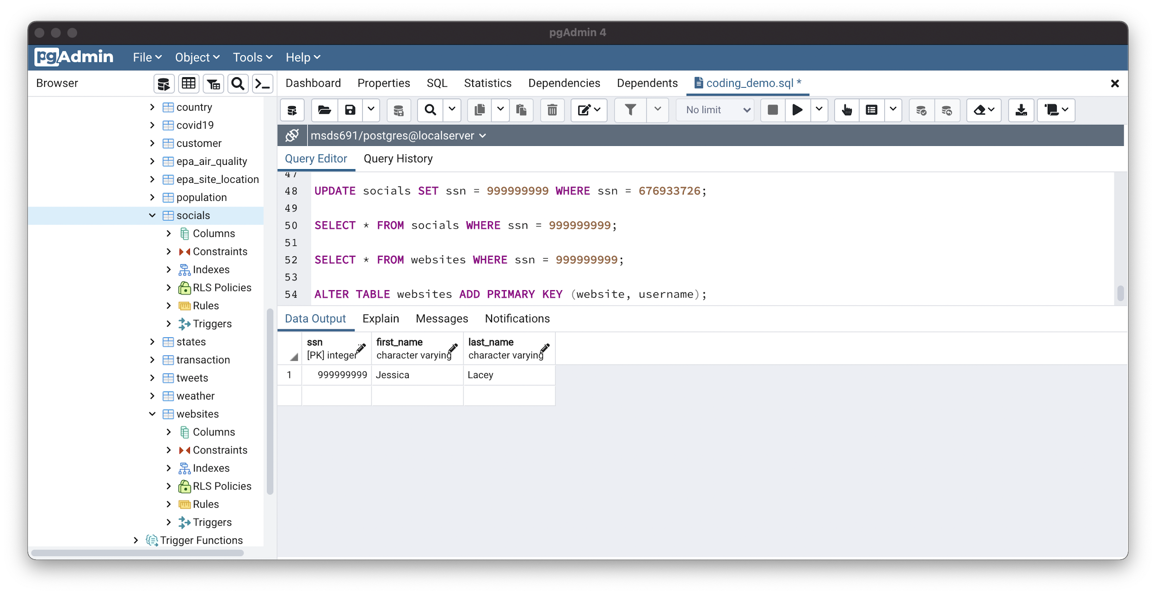
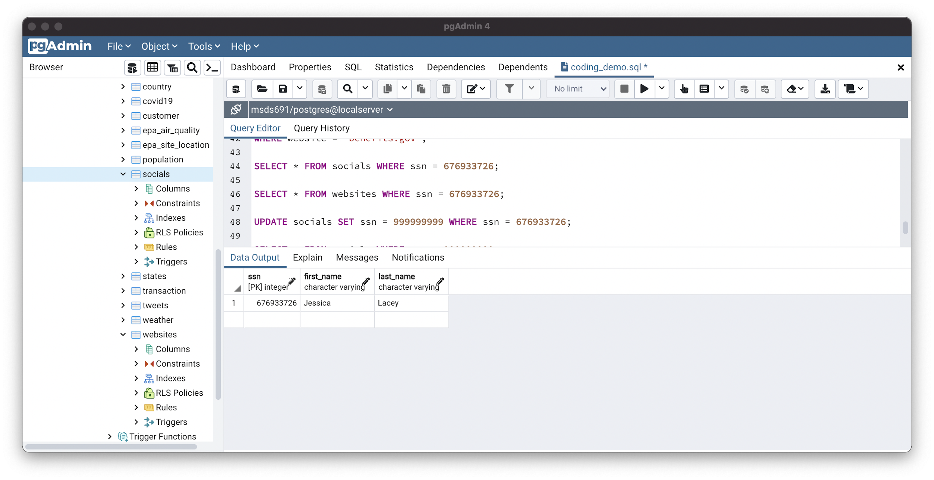

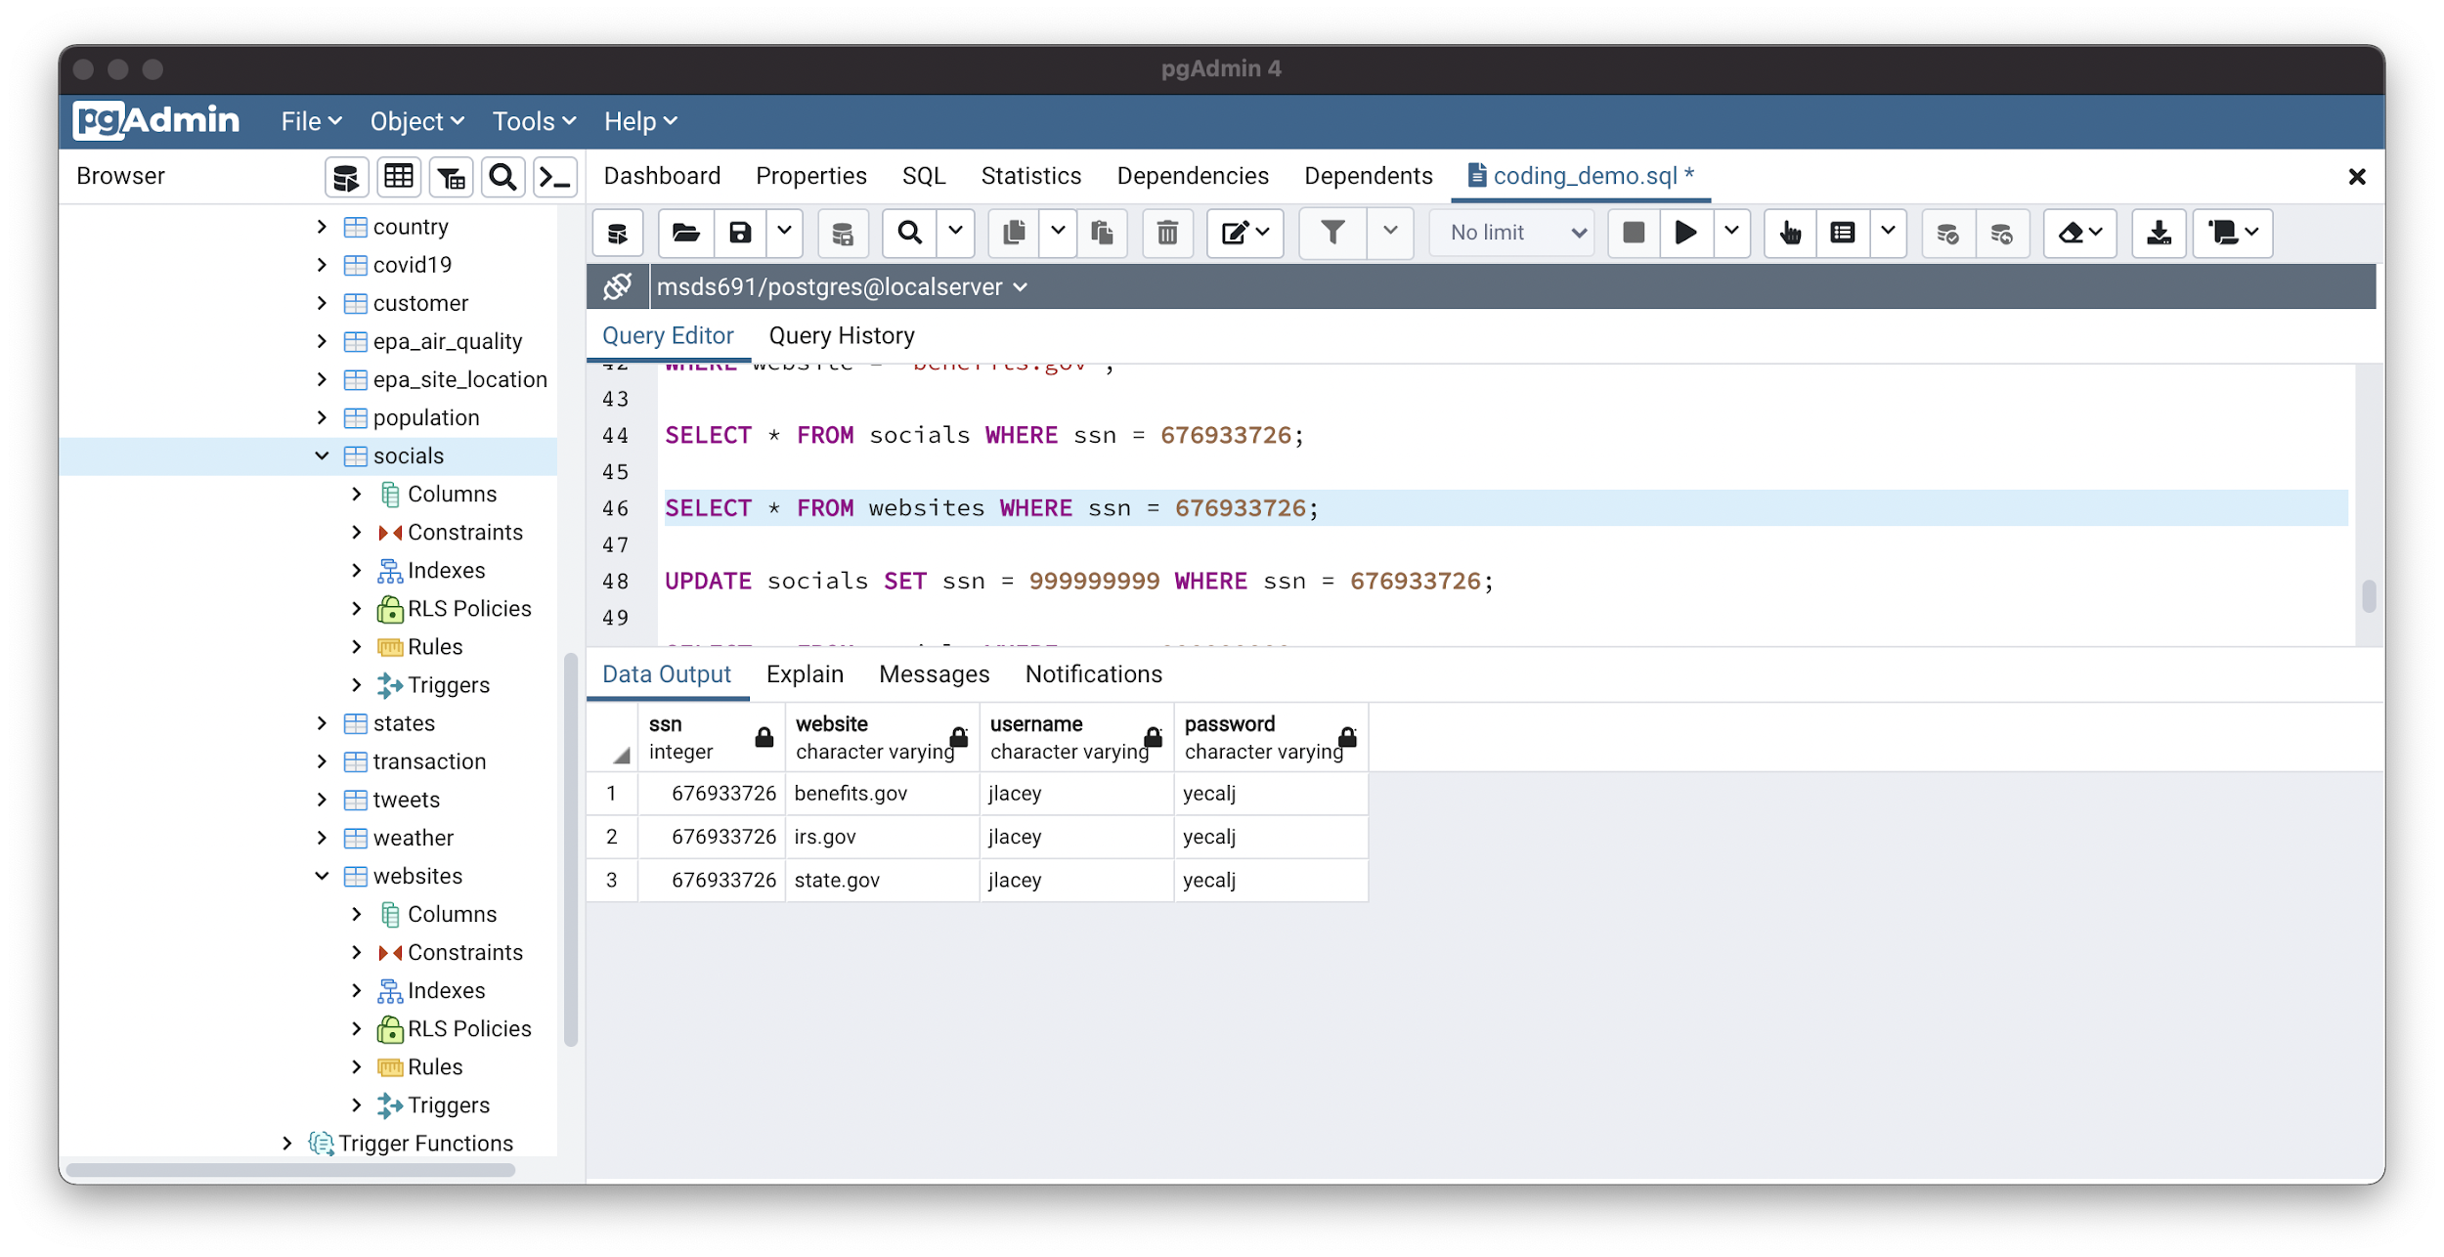
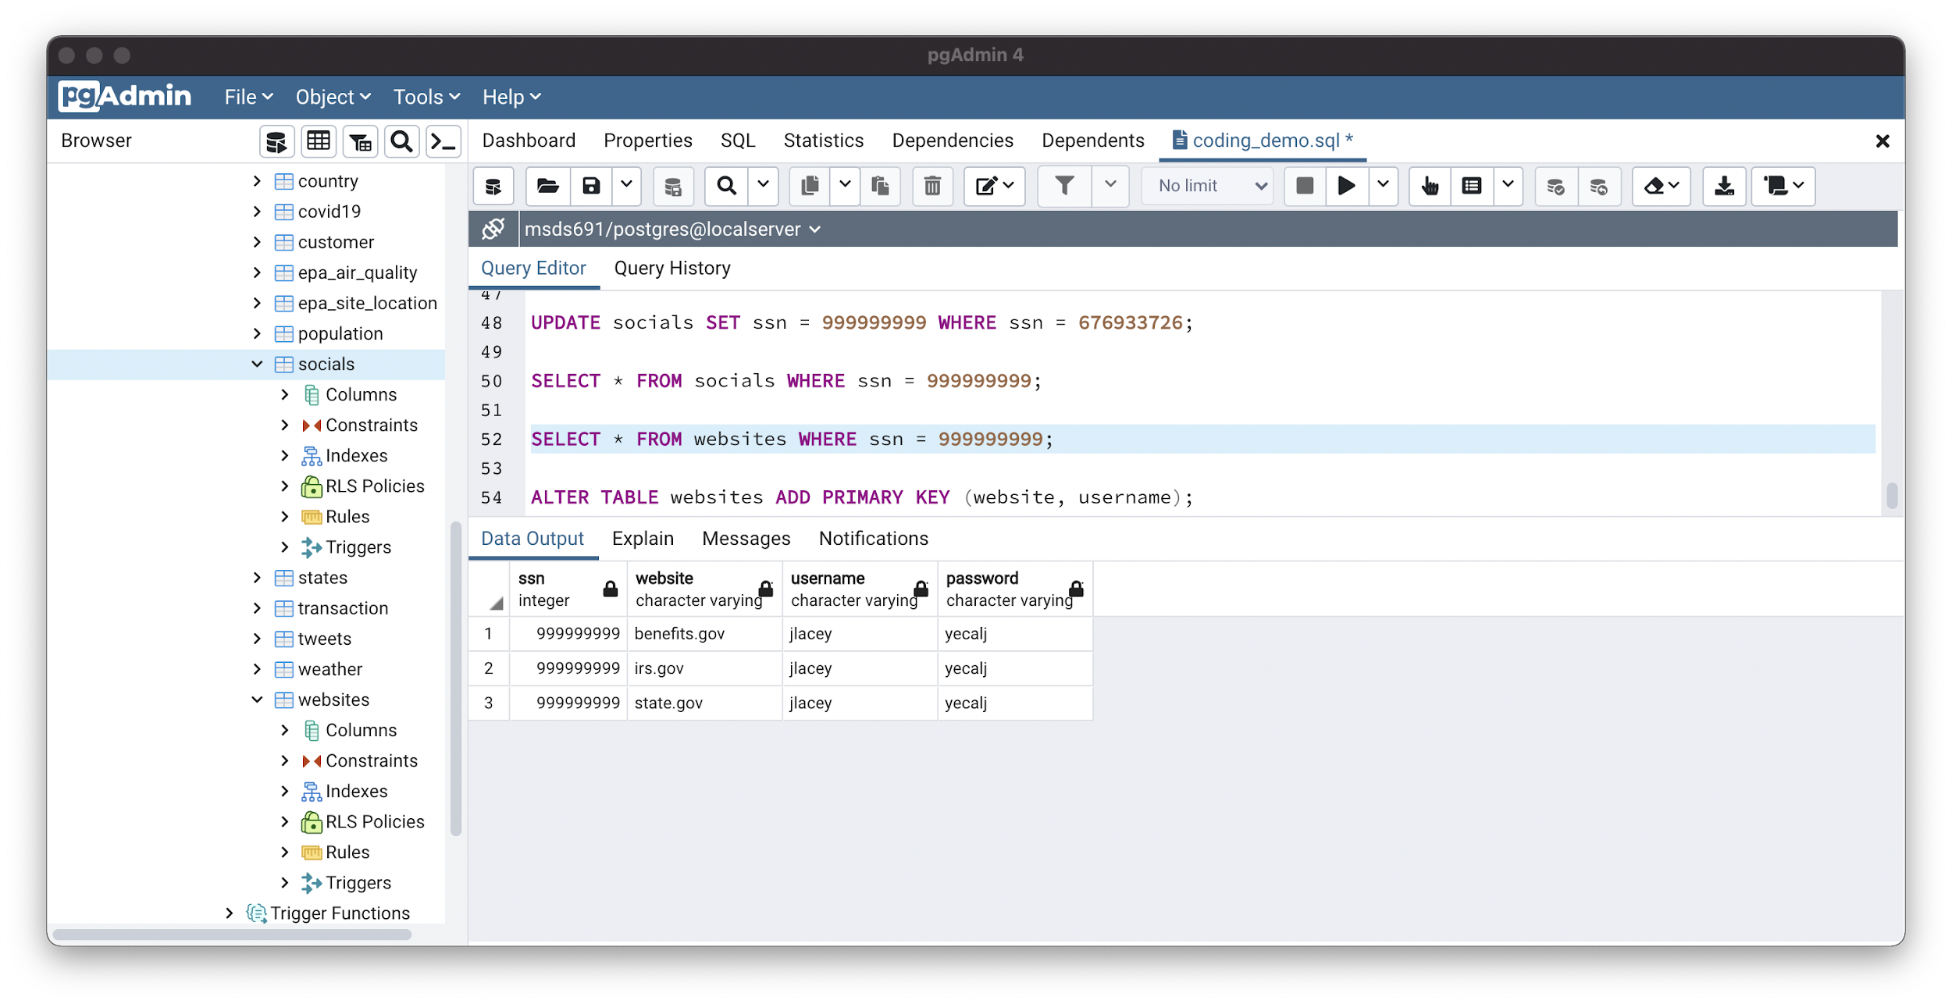
Foreign Key Use - Update
socials table
websites table
Notes:
Kaihang

Slide 11
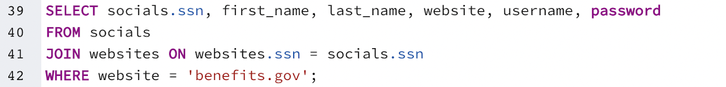
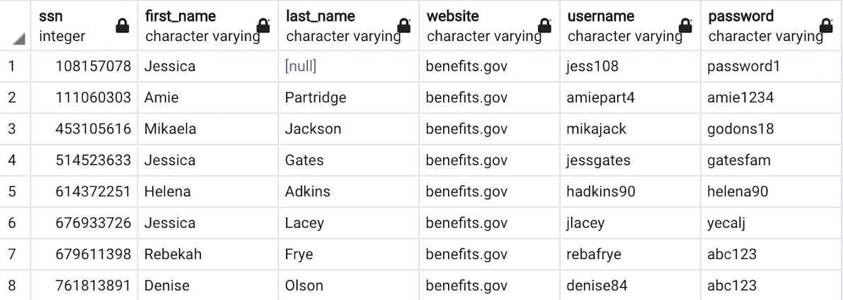
Foreign Key Use - Join
Notes:
Kaihang

Slide 12
Initialize Key After Table Creation
Primary Key
ssn | website | username | password
548801478 | irs.gov | jessicak | psswrd10
548801478 | state.gov | jessicak | psswrd10
108157078 | benefits.gov | jess108 | password1
446381146 | state.gov | tomass | godons18
Notes:
Kaihang

Slide 13
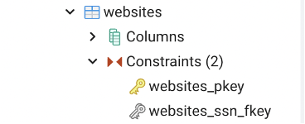
Dropping Keys
ALTER TABLE websites DROP CONSTRAINT websites_pkey;
Notes:
Kaihang

Slide 14
Conclusion
Three types of Database Keys: Primary, Unique, Foreign
Initialize Database Keys during or after table creation
Keys are used to efficiently search databases or link databases to each other
Notes:
Cameron

